Slide 1
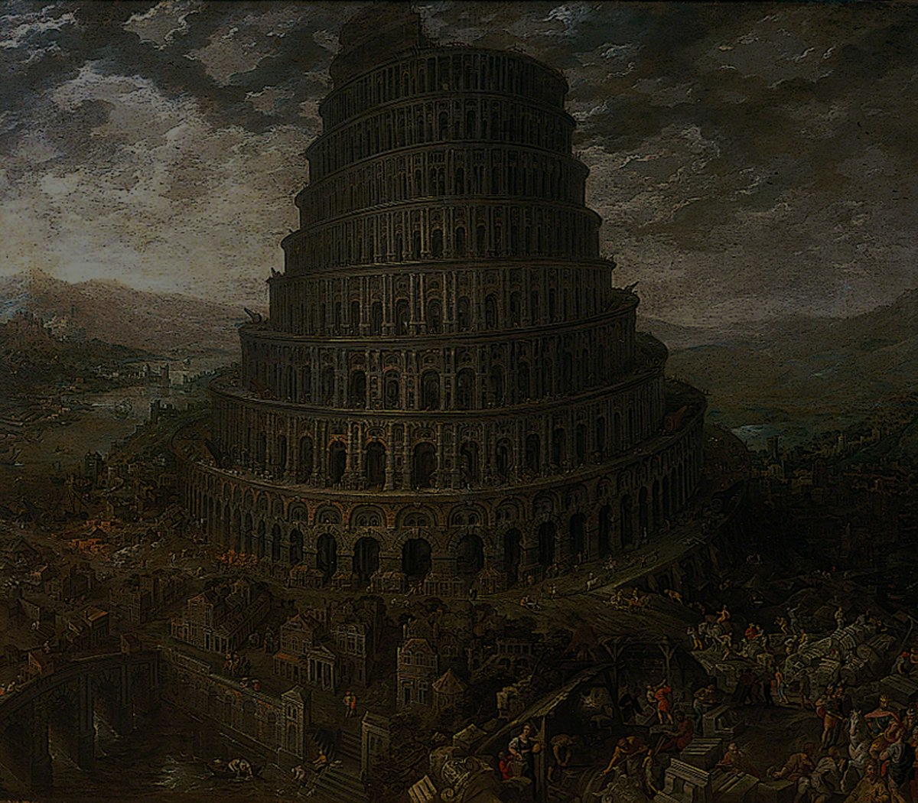
29 August - 1 September 2019
29 August - 1 September 2019
Euroclassica 2019
Universiteit Antwerpen - Stadscampus
29 August - 1 September 2019
POLIS EUROPA
Ancient Greek and Latin
in Multilingual Europe

