Slide 1

Monsters in the classroom: Latin and Greek at primary school
The conference starts at 2pm CET
La conférence commence à 14h CET

Slide 2

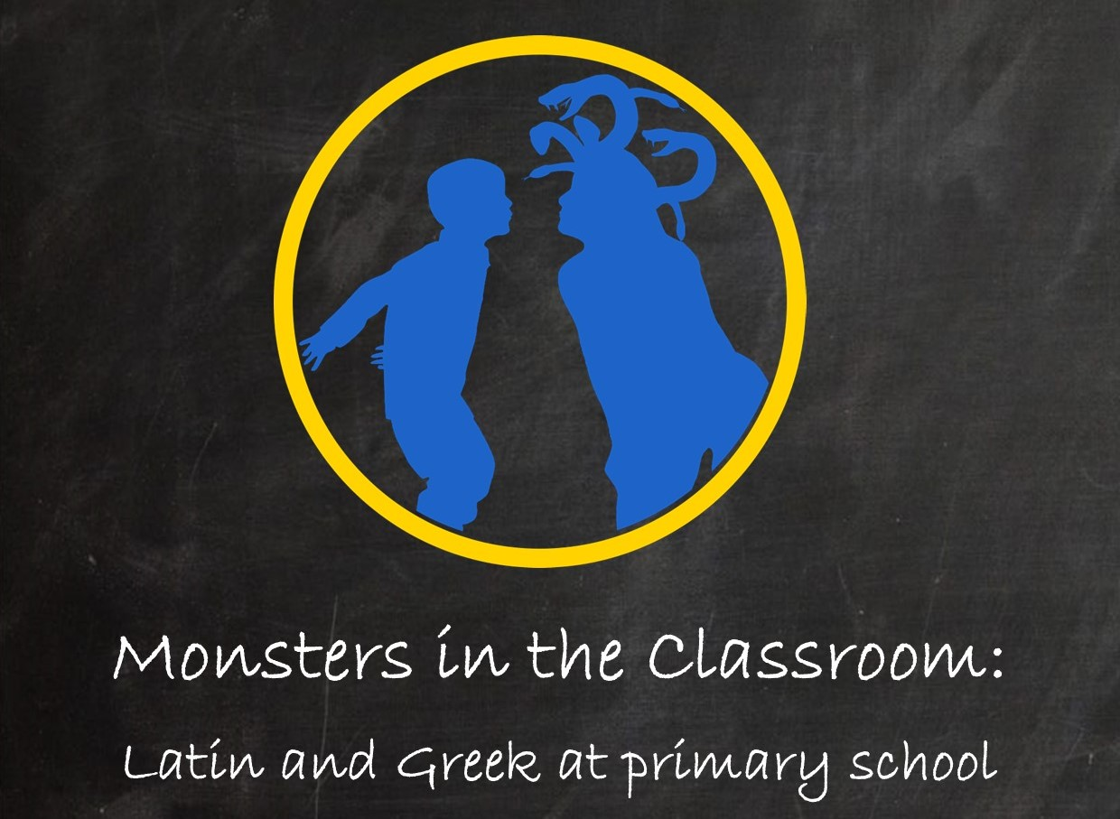

Slide 3
Conference programme
Session 1: Organization and cooperation
2.15-3.15pm CET
Alette Rosing: ‘Teaching Classics at primary school with the help of secondary school pupils’
Maria Oikonomou: ‘Teaching Primary via teaching Higher’
Jane Maguire: ‘Benefits of introducing Latin into UK Primary’
Discussion
Session 2: Pedagogy 1
3.25-4.05 CET
Liz Syed: ‘Using Comprehensible Input in the Latin primary classroom’
Riccardo Di Donato, Andrea Taddei: ‘Educare all’Antico: an experience in some Italian primary schools’
Discussion
Session 3: Pedagogy 2
4.10-4.55pm CET
Sofia Goula: ‘In Greek we trust: Παίζοντες μανθάνομεν’
Brigitte Franceschetti, Laurence Duchemin, Adrienne Durand: ‘Comment apprendre le grec ancien aux jeunes enfants: faire naître et grandir l’amour du grec en eux’
Discussion
Session 4: Inclusivity
5-5.45pm CET
Eleni Bozia: ‘’Translating’ Classics for generations Z and alpha’
Stefan Kipf: ‘Latin and inclusive language teaching: conceptual basics’
Discussion
5.45-6pm: Concluding remarks (Steve Hunt)
6-6.30pm: Online reception on Wonder

Slide 4
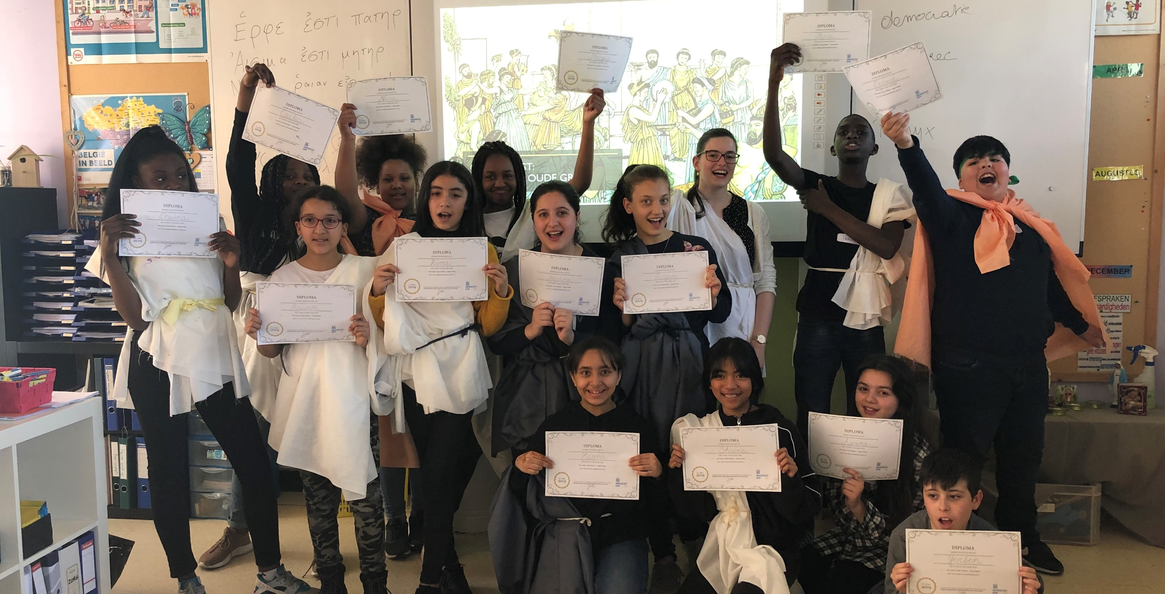
Ancient Greeks – Young heroes
Dr Evelien Bracke (evelien.bracke@ugent.be)
Notes:
Good morning, good afternoon, or indeed good evening everyone! My name is Evelien Bracke, I’m a lecturer of ancient Greek literature at Ghent University in Belgium. Together with Lidewij and Steve, whom you’ll meet later on during the conference, I’m delighted to meet so many colleagues interested in teaching Latin and Greek at primary school. You’ll hear all about lots of different projects from different countries in the next few hours: we really have a packed programme for you. However, as Lidewij said, to start, I just wanted to introduce briefly the project which formed the initial inspiration for this conference, namely the Ancient Greeks – Young Heroes project which I set up at Ghent University in 2019 and have coordinated since then.
This project brings ancient Greek language and culture to children growing up in poverty in the Flemish political region of Belgium. Child poverty in Flanders is on the rise, but children from a working class background or with a non-Belgian mother are at a much higher risk of experiencing poverty than their peers.
Growing up in poverty does not just mean less money is available: poverty covers every aspect of a child’s life, and has an impact on children’s physical and mental health, and later in life: their career trajectory and political participation. Most importantly for our context, it also means they tend to get fewer educational opportunities. Latin is still going quite strong in the Flemish region, as it is studied by around 10% of secondary school pupils. Yet research has shown that children growing up in poverty have disproportionately less access to Latin and Greek study than their peers: pupils from a disadvantaged background who have finished primary school and are moving to secondary school are encouraged to study Latin and ancient Greek far less than other children their age. This is not necessarily deliberate discrimination on anyone’s part, but it is discrimination all the same which has an impact on children’s lives. It reveals there are not only visible but actually mostly invisible social barriers which stop children from taking part in Latin and Greek.
The Young Heroes project wants to intervene in this discrimination and break down these barriers, whereby pupils don’t have access to Latin and Greek primarily because of their social background. And so I train my students to teach ancient Greek at primary school, since this is still a subject reserved for the linguistically brightest pupils in Flanders who have already studied Latin. At the start of the project, there are invariably teachers and pupils who say Greek will be to difficult, that it’s not for them. By the end of the project, however, all pupils have invariably engaged positively with the lessons to some extent, and have a more positive image of their cognitive abilities. By offering pupils a challenge at their own level, we want to make teachers and pupils aware of what pupils are capable of.

Slide 5
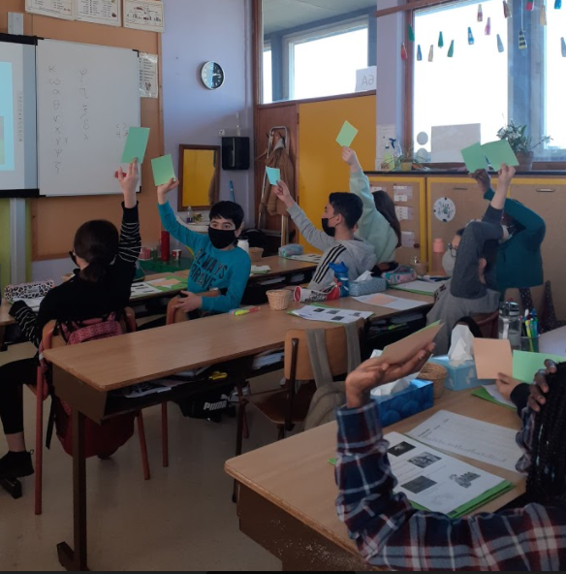
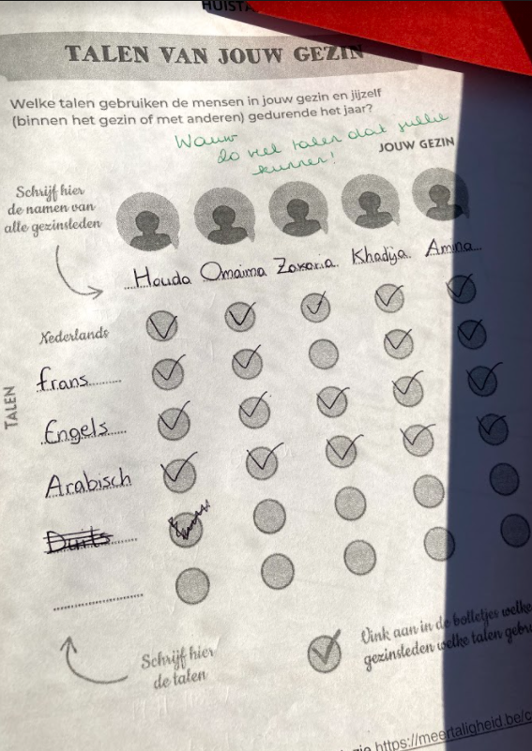
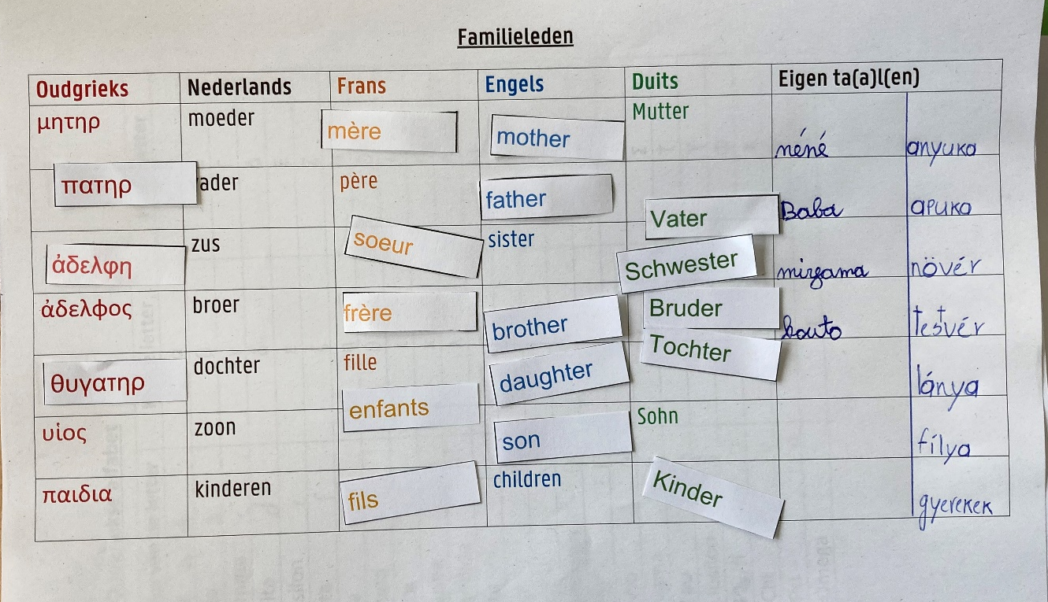
www.ancientgreeksyoungheroes.ugent.be
Notes:
Practically, my Ghent University students who are training to be teachers of ancient Greek teach Greek in two schools in the Flemish region, and a number of schools also use our resources themselves - all lesson plans are available on our website for free, in Dutch – one course on ‘monsters from various storytelling traditions’ also available in English via de link you can see there.
We don’t teach ancient Greek like it’s done in secondary school, but we start from pupils’ needs with regard to inclusivity and being heard and seen.
For example, home languages of pupils incorporated into classes, as the exercise on the right shows: when pupils have to find ancient Greek, Dutch, French, English and German words for family connections, they are also asked to add their own, which are then discussed in class. This is done to foster a sense of belonging and help integration of all pupils in the Flemish context – it’s a very popular activity most pupils get very excited by.
Activities whereby pupils can engage actively in knowledge creation together with the student teachers, such as the exercise on the left, whereby pupils were able to choose which next step a hero would take on his journey through the underworld.

Slide 6
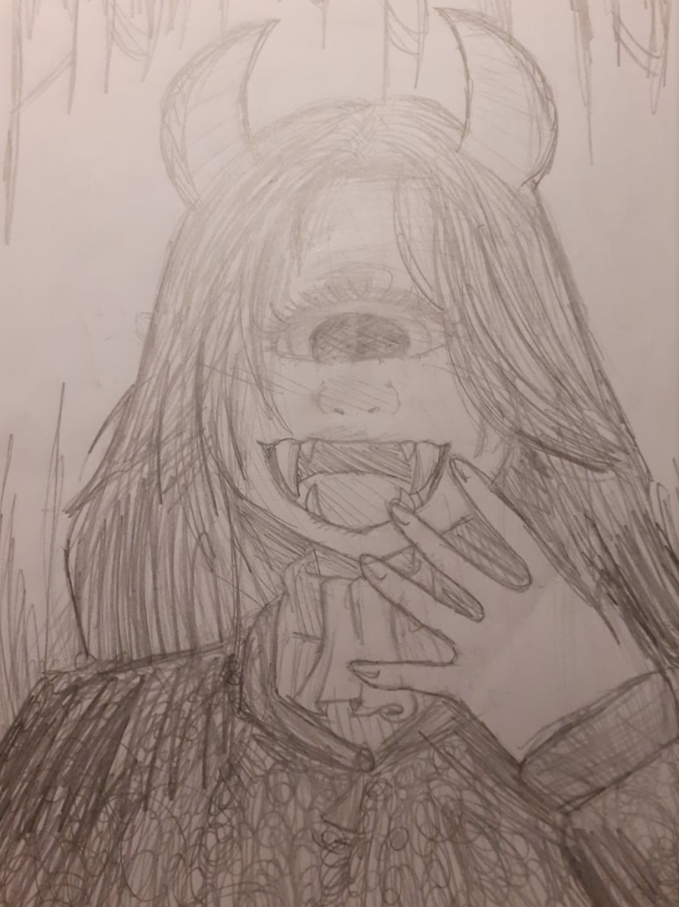
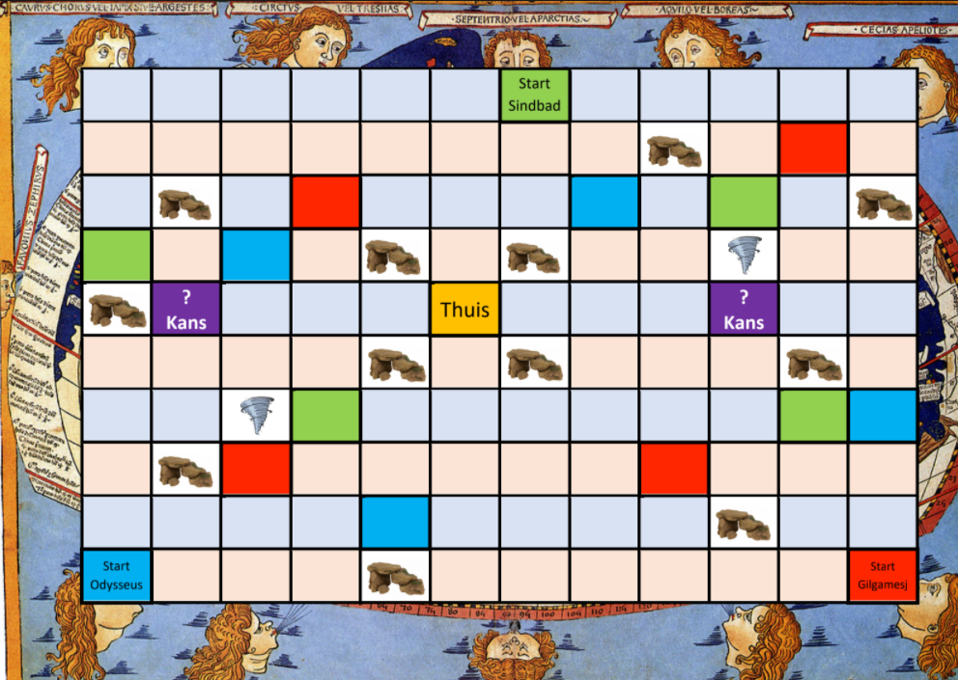
www.ancientgreeksyoungheroes.ugent.be
Statistically significant increase in reading comprehension in comparison with control groups
Increase in spelling in comparison with control groups
Increase in academic self confidence
English-medium teaching resources
collaboration with Museum of Antiquities (Leiden) and Leiden University
Notes:
We don’t expect pupils to reach a particular point in ancient Greek grammar or knowledge in general: non-linear learning: no assessment, focus lies on the enjoyment of language. Assessment is done via activites and board games such as the one on the powerpoint, whereby Odysseus, Gilgamesh and Sindbad all had to get home but pupils had to answer certain questions about their myths and ancient Greek language depending which square they ended on.
Helping pupils to broaden their mindset, e.g. in the course about monsters in storytelling traditions, we question what is a monster, what is a hero to help them think about similarity and difference; one activity is the creation of a monstrous self portrait, to help them loosen strict binary distinctions between normal and abnormal
Results of research I did in 2019 and 2021 on impact of the project on the pupils
I tested reading comprehension: statistically significant increase in reading comprehension in comparison with control groups
Increase in spelling in comparison with control groups
Increase in academic selfconfidence (small groups and control samples, so more research needed)
Current projects:
Book on the project for Routledge, to be published towards the end of teh year
English-medium teaching resources on website – more soon plus French
collaboration with Museum of Antiquities (Leiden) and Leiden University: online lessons teaching ancient Greek by means of museum objects so even more pupils in the Netherlands and Flanders can learn Greek. These resources will be shared during the Week of Classics in the Netherlands, in March.
So Young Heroes is the project I’m currently working on in Flanders. However, I’ve been working on teaching Latin and Greek at primary school for over a decade now – before Belgium, I worked in the UK for ten years where I coordinated a similar project at Swansea University.
In the eleven years I’ve now worked on making Latin and ancient Greek accessible for primary school pupils, I’ve often felt I was (and am) going against the grain: in most countries, Latin and Greek are not part of the primary school curriculum, and in many countries, they are under threat at secondary school. So persuading teachers, school boards, parents, and sometimes also pupils that Latin or ancient Greek is something that might be interesting for the pupils, is not easy. I also felt alone in going against the tide at times, even though I was aware of other projects doing similar things.
But as today’s speakers will also be able to attest to, the vast majority of pupils who come into contact with Latin or ancient Greek at primary school already, find it a hugely rewarding experience, as do many teachers. The talks will also resonate with each other, I’m sure, and demonstrate that we don’t have to reinvent the wheel to teach Latin or Greek at primary school, since people in different countries have been working away at their own projects for decades. By sharing good practice and expertise internationally, we can hopefully further help and support each other.
The title of the conference encompasses the joy and difficulties of teaching Latin and Greek at primary school. We chose the title ‘monsters in the classroom’ to refer of course to the wonderful stories from mythology that pupils so enjoy. The child in our logo is joyfully engaging with Medusa, not (literally) petrified by her but able to look her in the eyes. But we also want to refer to ‘real’ monsters in the classroom, wether they are difficulties teachers encounter when starting to teach Classics at primary school, or ideas in people’s minds about what Latin and ancient Greek are, and more importantly, who they are for.
Today’s talks are therefore delibaretely not theoretical: they are practical accounts by experienced teachers who work in their specific country. Not everything will be relevant for everyone’s own context, but we hope the talks will offer both inspiration and food for thought.

