Slide 1
“Translating” Classics for Generations Z and Alpha
Eleni Bozia Universiteit Ghent
Associate Professor OIKOS
Department of Classics Monsters in the Classroom
University of Florida January 26th, 2022

Slide 2
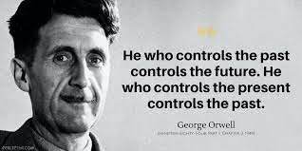

Slide 3
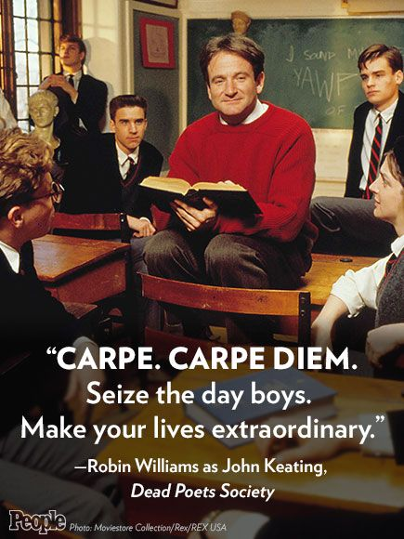

Slide 4
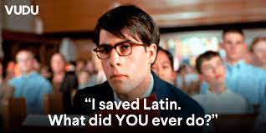

Slide 5
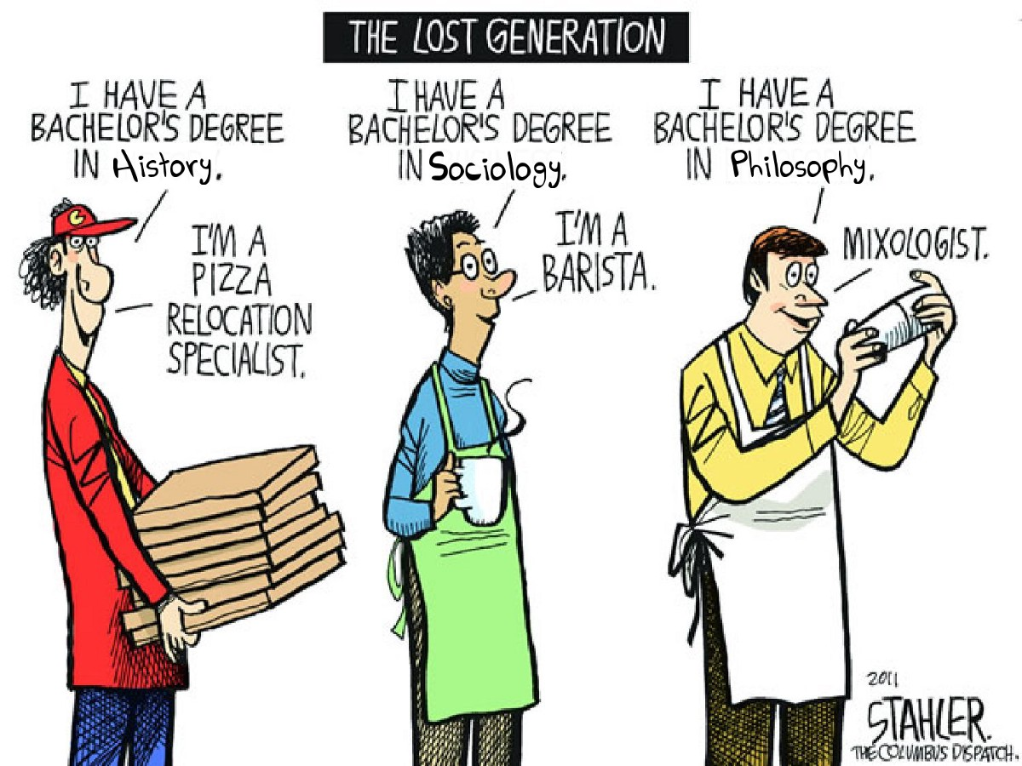

Slide 6
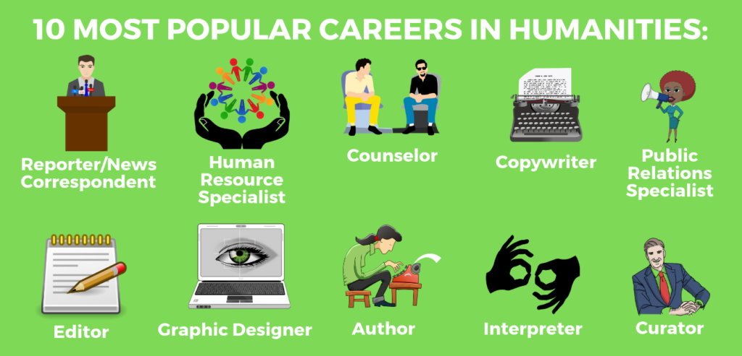

Slide 7
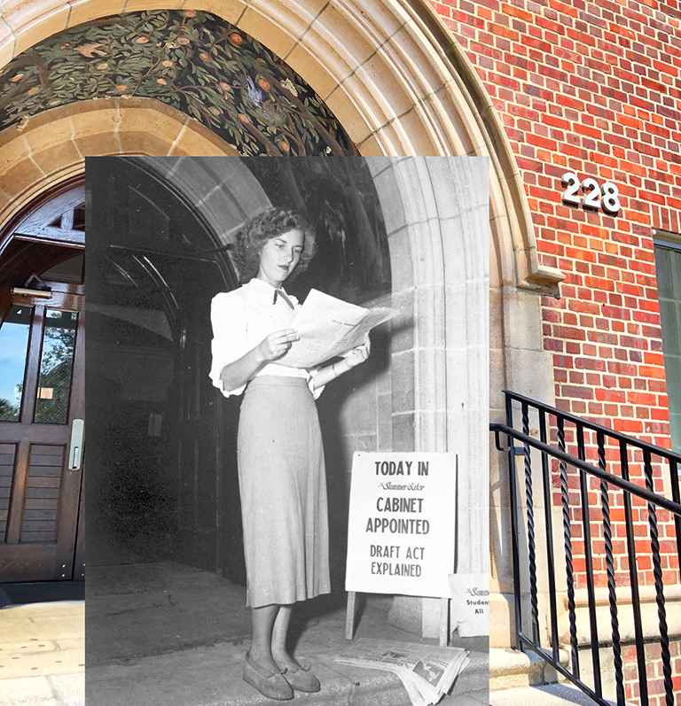
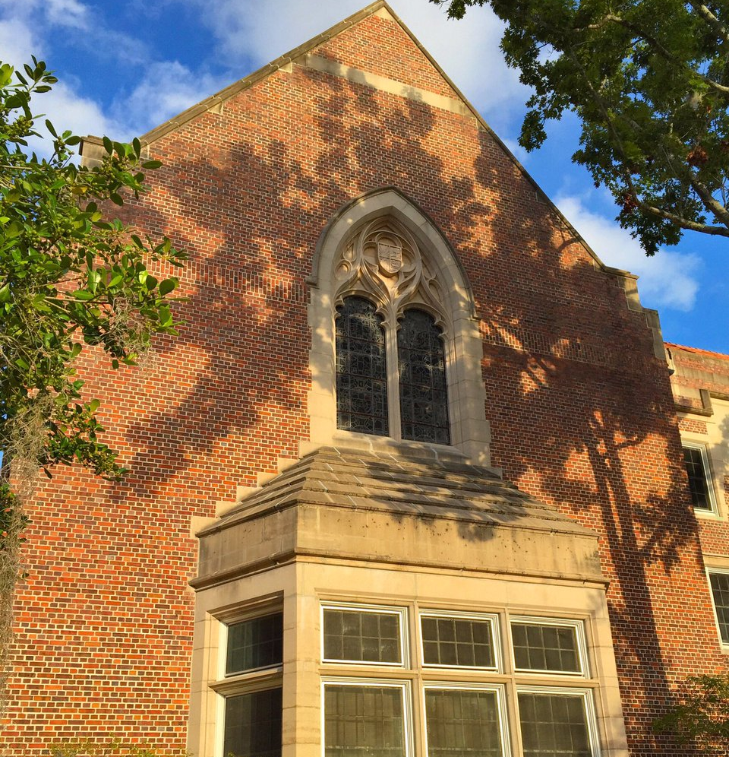

Slide 9
EMPOWERING GIRLS (Organizers: Anthony J. Smith & Anastasia Pantazopoulou)
By high school, less than one third of girls feel confident and positive about themselves”
(https://www.accreditedschoolsonline.org/resources/girls-health-happiness/).

Slide 10
The Program
Event 1
• Event 1: Council of the Gods
Event 2
• Event 2 Guess Muse
Event 3
• Event 3: Parallel-o-Gram
Event 4
• Event 4: Career Week
Sessions & Activities

Slide 11
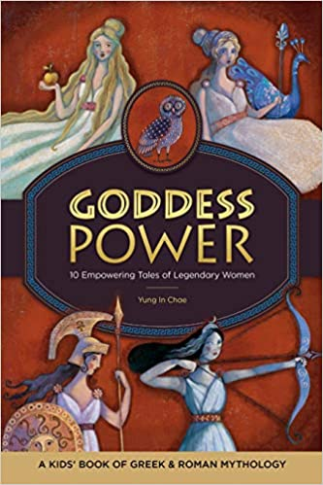
Getting to know you
Are you familiar with any of the following ancient mythological figure?
Do you know in the tradition of which civilization(s) we find the previous mythological figures?
Do you consider yourself a leader?
Do you know how to stand up for yourself?
What do you want to do when you grow up?
From just the title of this program, what do you think we’ll explore over the next few weeks
Tell us anything you know about the following figures: Malala Yousafzai, Ruth Bader Ginsberg, Simone Biles, Greta Thunberg. It’s okay to say you don’t know anything 😊
Do you know what the term ‘Humanities’ means? Explain what you think it means.

Slide 12
Council of the Gods:
Athena & Poseidon in the Courtroom
The girls participated in a court-like situation, based on the council of the gods in Homer’s Odyssey which takes place on the top of Mount Olympus where the gods are deciding about Odysseus’ fate. After listening to the cases that Athena and Poseidon made about Odysseus’ innocence, the girls were asked to decide whether Odysseus should return home or not.

Slide 13
Guess Muse
The girls “met” the 9 Muses, learned about how they relate to Humanities, and then went on a clue-hunt to figure out what each of the Muses represent and what their traits are.

Slide 14
Parallel-o-Gram
We discussed the stories of Antigone, Nike, Themis, Demeter, Malala Yousafzai, Simone Biles, RBG, and Greta Thunberg, detecting similarities in the stories of these inspirational female figures. The girls were then asked to focus on one of pair of an ancient-contemporary inspirational female figures and create a storyboard about a meeting these two would have.

Slide 15
Career Week
We revisited the paths one can follow in Humanities and took a short virtual tour of our UF campus. Then, the girls had the chance to interact with three of our Classics professors (Dr. Eaverly, Dr. Bozia, and Dr. Iff-Noël).

Slide 16
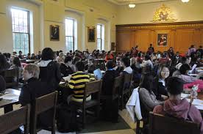

Slide 17
sustainability

Slide 18
Academia & Beyond

Slide 20
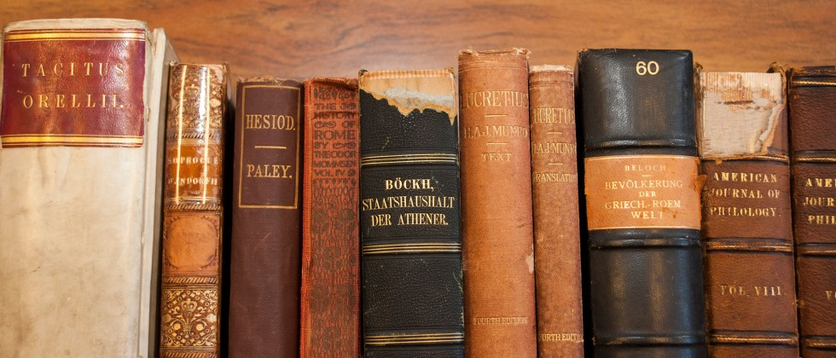
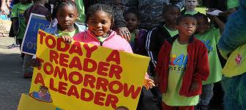
Classics for all
Memory, Culture, History, Language, Imagination, Art at Work

