Slide 1
Compelling Comprehensible Input in the Primary Latin Classroom
Liz Syed
What is comprehensible input?
Messages in the target language that are understood.
The human brain requires comprehensible input in order to acquire language.
Notes:
Comprehensible input in the Latin classroom
What it is
Why it’s useful for us in Latin teaching
A simple strategy to use it in class.
Comprehensible input is what we, as humans, need to acquire language.
Comprehensible input is language that we hear or read in the target language, that we UNDERSTAND.
Our brains naturally acquire language when we receive messages in the target language that we understand; it’s what our brains are wired to to do.
It’s how we learnt our first language, as a baby/toddler, and it’s how we learn any other language too.
And if what you’re HEARING and READING is compelling, i.e. really interesting for you, you’re going to focus more, listen even more attentively.
So how does this help us with the teaching of Latin at Primary School?

Slide 2
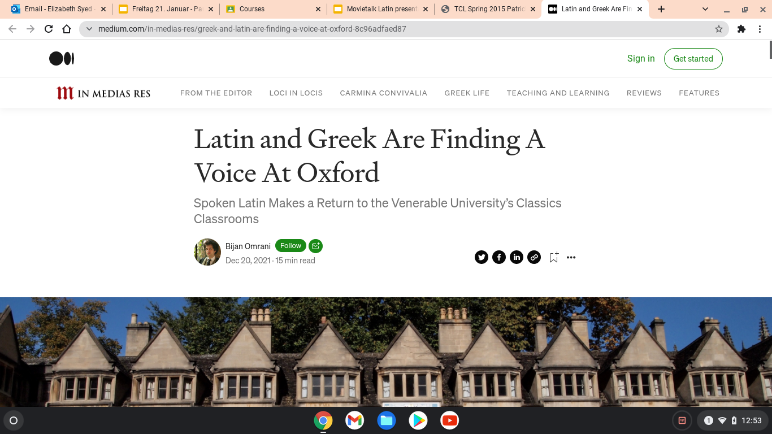
Using more spoken Latin in the classroom:
Help students acquire Latin naturally
See Latin as a “proper”, living language
an inclusive approach
Spoken Latin in the classroom:
A simple strategy
Notes:
All of us are probably aware of the growing movement to use more SPOKEN LATIN in classrooms
Why do this?
to help students acquire Latin “naturally”
So pupils view Latin as a “proper”, living language, which they can use to communicate with others, just like any other language.
There are so many advantages to this approach, which we don’t have much time discuss in detail… but for the purposes of this talk, I’m going to start from the position that spoken Latin is a very positive thing, that our pupils will benefit from experiencing, and I’ll show you one simple strategy you can use straight away in your classroom, to include more comprehensible input for your pupils, to give them the opportunity to acquire Latin and enjoy interacting in it in class, from an early age.
By using spoken comprehensible Latin in your classroom, you are reaching all your learners, including pupils who traditionally might not have been successful with a more traditional, grammar heavy approach.
With CI, not just to the students who have excellent memories for lists of vocabulary or find grammar fascinating.
When we speak comprehensibly in class, every learner can be successful; it’s an extremely inclusive approach.
Please do read this article about Oxford University, who are starting to include a lot more spoken Latin in their classroom; the link to the article is at the end of the slides.

Slide 3
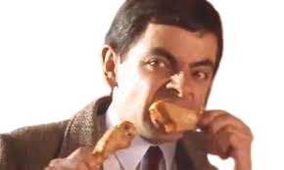
What is Movie Talk?
Play a short film clip, sound off, while explaining it in comprehensible Latin..
Establish meaning - Repetition
Pause often; discuss what you see. Ask questions and personalise the input.
Focus on comprehensible language.
Check for understanding.
Then let the students watch from the start, uninterrupted, sound on.
Afterwards: work with the text, (matching, sorting, sequencing, gap-fills etc) or just move on.
Notes:
This is a really easy strategy to implement.
Very popular among MFL teachers; it even has its own name.
(Go through slide)
These films are examples of clips I use often in Latin lessons -Mr Bean, (funny, relevant to topics we cover such as Roman food; no dialogue, only action) Simon’s Cat (also great to link with Minimus due to all the references to cats and mice!) ; Magister Craft, nice cultural links here and although the story isn’t as gripping and there’s more talking, they find the Minecraft element engaging.

Slide 4
Why Movie Talk?
Students hear interesting spoken Latin that they understand
(compelling, comprehensible input).
Harness the power of a story!
It can be culturally relevant - (but doesn’t always have to be).
Introduce new vocabulary
“Pop-up” grammar
Differentiated teaching
Inclusive approach
Easier introduction to speaking Latin in class for teachers.
Notes:
Students are receiving a lot of comprehensible input and their brains are acquiring the language naturally as they listen with understanding.
Story: with Movietalk, the pupils’ attention is held by the images on the screen that are compelling, they tell a good story, behaviour and attention is never an issue, I’ve found.
Although you can use clips related to Roman civilisation of course, it does not have to be - the main thing is a good story, short, and with plenty of actions - may or may not be related to ancient civilisation. Greek mythology can work well but there’s a lot going on - have to be careful not to use too much vocabulary at once.
This is a great way to introduce new vocabulary in an engaging way, - not too much - you want to limit the amount of vocabulary but provide lots of opportunities to repeat it often, in context, - and to introduce or revise grammatical points as they occur in context - briefly, then move on, no more than 20 seconds. “Pop-up” aspect of grammar.
Differentiated naturally, you can use the same clip for all levels and ages, from beginners to advanced levels. You just plan the questions and language accordingly.
One of the great thing about Movie talk is that it gives you a structure of what you’ll say, you don’t have to be at all spontaneous if you don’t want to be. You can plan it down to the last word and write script, especially until you get the hang of it. An easy way to start using more spoken Latin in class.

Slide 5
Example Script (prepared in advance)
0:08 | ecce puer!
0:11 | puer Xbox ludit.
0:21 | mater intrat. quid mater habet? mater arcam habet.
0:41 | in arca donum est.
0:51 | quid donum est?
0:55 | canis donum est!
1:04 | canis tria crura habet, non quattuor.
1:09 | puer iratus est, quod canis tria crura habet.
1:15 | canis ludere vult
1:19 | puer non ludere vult.
1:27 | canis pilum videt.
Credit: Keith Toda
Notes:
This type of script is helpful to prepare in advance, especially at first, as you get used to speaking Latin. You don’t have to put the times you’ll pause the film, but it can help to plan it out.

Slide 6
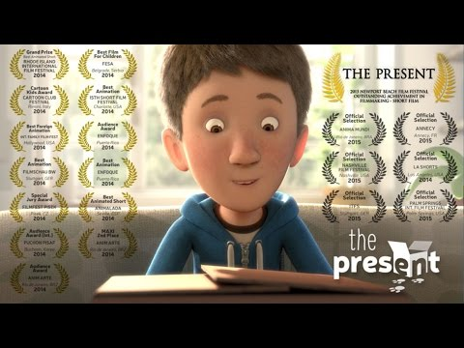
ludit plays
intrat enters
habet has
arca box
donum gift
ecce! Look!
crura legs
iratus angry
vult wants
pilum ball
sic yes
minime no
an or
quis? Who?
quid? What?
Notes:
This is what I would have on the board for this particular film; words they know, some new words (in bold, in the blue box), and the yellow box contains familiar words that help me to ask questions as we go along. I can pause and go and point to these words as I use them - this helps me to slow down my own speaking too.

Slide 7
Notes:
The other way to do a Movie talk, rather than playing the video and pausing it, is to take screenshots from the clip and talk about them, and then play the film at the end all the way through. If you do this, you’ll need to get this free Youtube Screenshot Chome extension which will save you hours!
Now I’ll ask you to be my students for just a minute or two, while I show you what I mean.

Slide 8
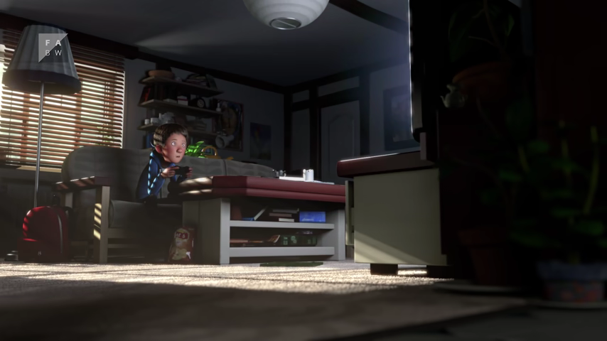
ecce puer!
quis puer ludit?
Notes:
If I’m playing the video and pausing, I start the film and pause it here. I ask a question. And personalise the input as much as possible, relating it to pupils in class.

Slide 9
puer Xbox ludit.

Slide 10
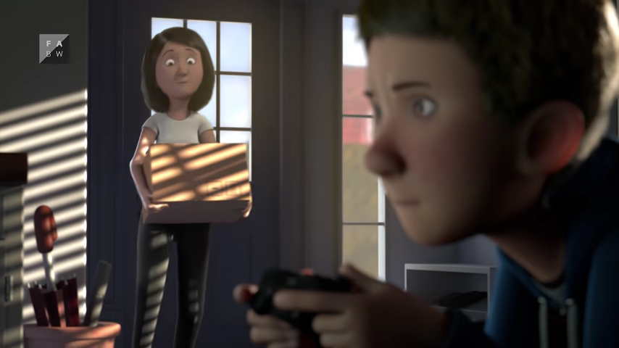
mater intrat.
quid mater habet?
mater arcam habet.

Slide 11
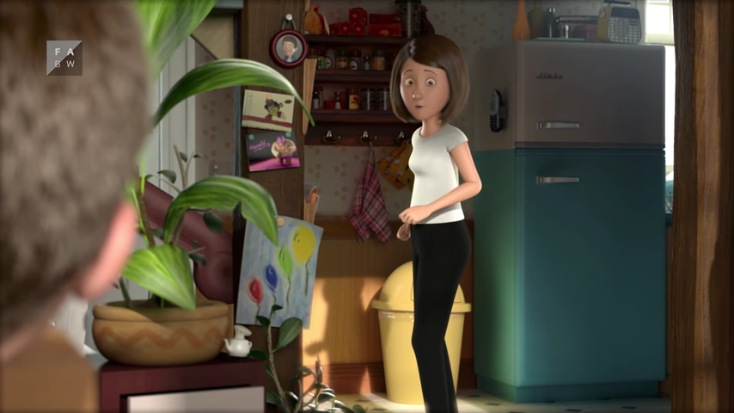
in arca donum est.

Slide 12
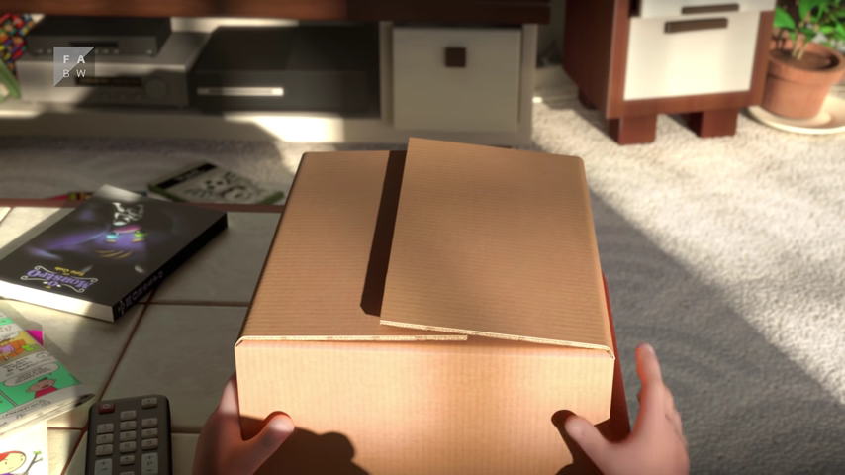
quid donum est?

Slide 13
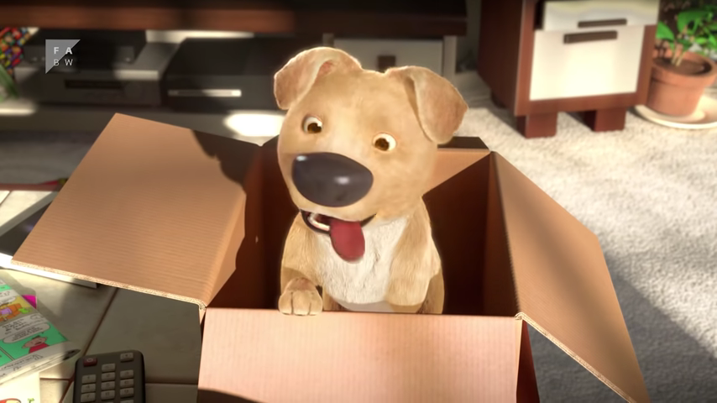
canis donum est!

Slide 14
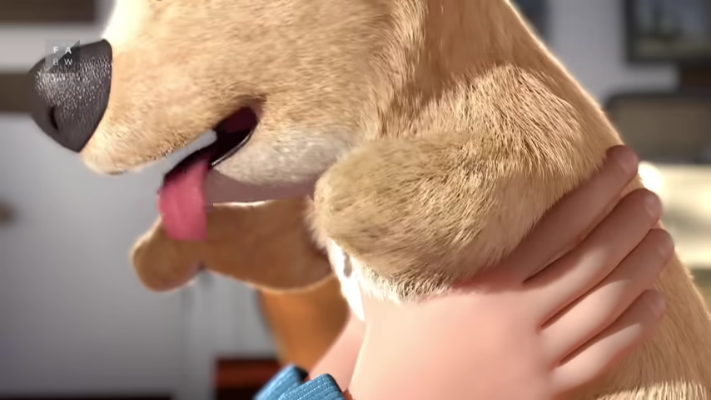
ecce!
canis tria crura habet,
non quattuor.

Slide 15
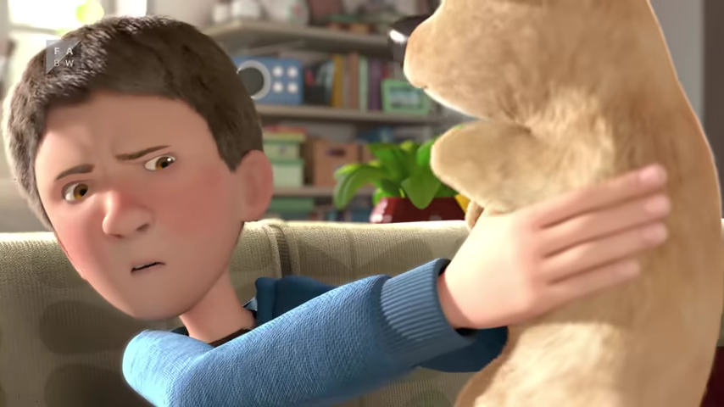
Puer iratus est, quod canis tria crura habet.

Slide 16
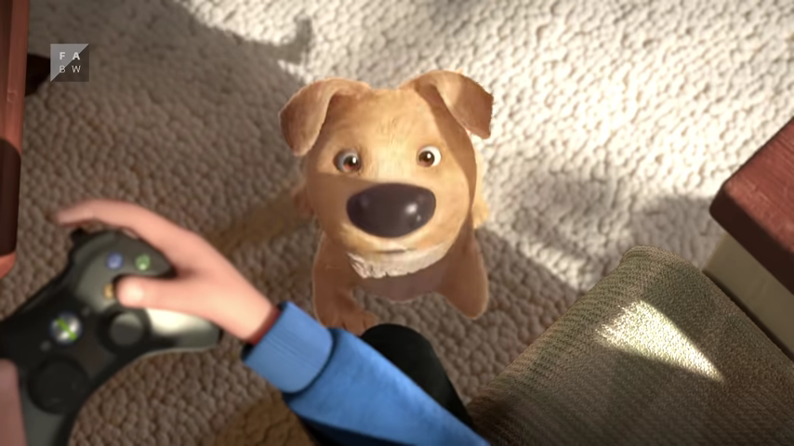
canis ludere vult.

Slide 17
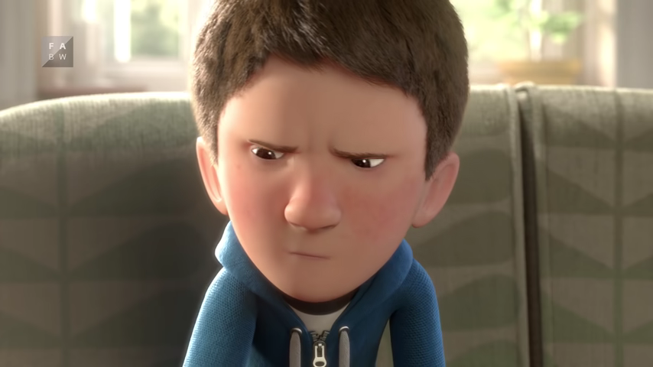
puer non ludere vult.

Slide 18
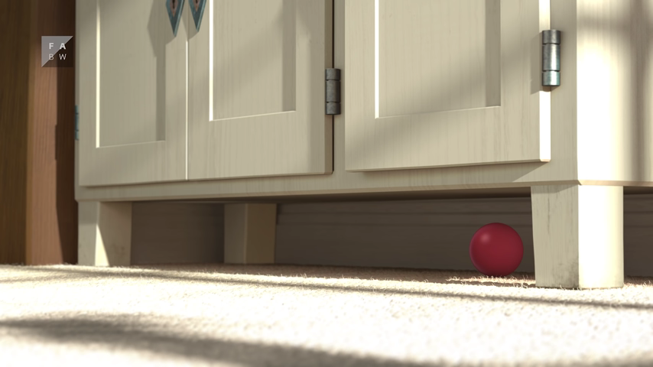
canis pilum videt.
Notes:
At this point, I would usually stop, and let them watch from the beginning.
Here, there is a twist in the story, and everyone loves it.
They will have had perhaps twenty minutes of pure Latin comprehensible input and I feel like they deserve to enjoy seeing the whole thing - it’s only 3.5 minutes long. They will enjoy the film and it’ll stay in their heads long after the lesson has finished, as will the Latin.

Slide 19
2.36

Slide 20
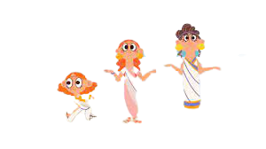
Some short clips and films successfully used in my Latin classroom as Movietalks: (click for links to Youtube)
The Roman House - Magister Craft
Animals: cat, mouse (supports Minimus vocabulary)
The Military - arrows, spears, soldiers etc.
Four sisters in Ancient Rome: I don't do this in one go, as a Movietalk; usually a short section or two.
Going shopping at market
Food; a funny clip, and several Roman foods are shown.
Notes:
You can click on the links on this slide to go to the films here - all these are films I’ve used as Movie Talks relating to our curriculum, for example, the shopping one related well to the unit in Minimus on buying things, and with Cambridge Latin Course too.
The Military one is great for when you’re introducing the Roman army, and vocabulary around that.

Slide 21
Topic | Related to Roman Civilisation
House and family | Magister Craft https://youtu.be/evJ7J1eqH2Y Four sisters in Ancient Rome https://youtu.be/RQMgLxVxsrw
Food | Blue Peter Roman Banquet https://youtu.be/9CqDKkcguDk
Baths | 4:20 Ted Talk Teenage boy in Ancient Rome https://youtu.be/juWYhMoDTN0 Magister Craft https://youtu.be/HBT_PmbGADU
Animals | Magister Craft Nocturnal animals https://youtu.be/6Y7i3PgdYNc
Shops | Pompeii shop excavated https://youtu.be/sHNH5sxK15o
Army | Magister Craft Roman Camp https://youtu.be/IoV4IY1OYQU
Not Roman!
The Present https://youtu.be/WjqiU5FgsYc Destiny https://youtu.be/wEKLEeY_WeQ Blues https://youtu.be/gwwycLz32Z0 The Incredibles https://youtu.be/Fs84VdehyCs
https://youtu.be/0WvKJhwea1U Mr Bean, fast food
Bathtub animals (good opportunity to recap animal words) https://youtu.be/WOUuWWYZo4c
https://youtu.be/TayIfVa0QPs Simons cat - cat and mouse. Works well with Minimus! The Simon’s Cat films are always a good source of Movietalk material.
Dog goes to market https://youtu.be/j9rqCaQsAA8 The Bread https://youtu.be/Wlf1T5nrO50 Alma https://youtu.be/Aw0uORumRts Mr Bean https://youtu.be/6lIPvYGex2s
Sketchy Guard https://youtu.be/LqktZhj7EFk
Notes:
These are all great for Movie talks, very engaging and link directly to units you might be covering in class.

Slide 22
Where to find out more?
Latin-specific websites to find out more about comprehensible input in the Latin classroom:
Keith Toda (has Movietalk ideas
and example scripts)
John Piazza
Justin Slocum Bailey
Latin Best Practices
Lance Piantaggini
Some excellent blogs on C.I. in the Latin classroom:
Excellent, comprehensive Article by Bob Patrick about using comprehensible input in the Latin Classroom
Justin Slocum Bailey writes about starting to use spoken Latin here
Spoken Latin and Greek being introduced at Oxford University Read the article here from In Medias Res, Dec 2021
Movietalk Database link: search for short clips here.
Notes:
These are all great places to start if you are interested in finding out more.
Movie Talk is only one way of bringing more comprehensible input into your Latin classroom, there are plenty of other really motivating strategies for younger learners too; have a look at Keith Toda’s blog.
Please email me if you would like to chat about anything relating to Movie Talk, or any other CI strategies.

Slide 23
Thank you for listening!
Email: lizsyed@gmail.com

